Slide 1

CO3
Discuss and apply comprehensively the concepts, properties and theorems of functions, limits, continuity and the derivatives in determining the derivatives of algebraic functions

Slide 2
COVERAGE

Slide 3
Objective:
At the end of the discussion, the students should be able to evaluate limits and determine the derivative of a continuous algebraic function given in the explicit or implicit form.

Slide 4
The Calculus

Slide 5
Calculus
Is the mathematics of change
two basic branches: differential and integral calculus

Slide 6
Lesson 1 : Functions and Limits

Slide 7
- A relation between variables x and y is a rule of correspondence that assigns an element x from the Set A to an element y of Set B. - A function f from set A to set B is a rule of correspondence that assigns to each element x in the set A exactly one element y in the set B. It is a set of ordered pairs ( x, y) such that no two pairs will have the same first element.
FUNCTIONS

Slide 8
Mapping of X- values into y-values ( 1 -1 correspendence)
1
2
2
4
3
6
4
8
5
10
X
Y
Domain (set of all x’s)
Range (set of all y’s)

Slide 9
Mapping illustrating many – 1 correspondence
1
2
2
4
3
6
4
8
5
10
X = Set A
Domain Set
Y = Set B
Range Set

Slide 10
Mapping of the elements of Set A in to Set B illustrating 1 – many type
of correspondence.
1
2
2
4
3
6
4
8
5
10
X = Set A
Y = Set B

Slide 11
Function Notation
We commonly name a function by letter with f the most commonly used letter to refer to functions. However, a function can be referred to by any letter.
The function called f
f(x) defines a rule express in terms of x as given by the right hand side expression.
The independent variable, x
Note: The value of the function f(x) is determined by substituting x- value into
the expression.

Slide 12
PIECEWISE DEFINED FUNCTION
A piecewise defined function is function defined by different formulas on different parts of its domain; as in,

Slide 13
Graph of a Function
The graph of a function f consists of all points (x, y) whose coordinates satisfy y = f(x), for all x in the domain of f. The set of ordered pairs (x, y) may also be represented by (x, f(x)) since y = f(x).
Recall: The Vertical Line Test
A set of points in a coordinate plane is the graph of a function y = f(x) if and only if no vertical line intersects the graph at more than one point.

Slide 14
ODD and EVEN FUNCTIONS
A function is an even function if and only if
The graph of an even function is symmetric with respect to the y-axis.
A function is an odd function if and only if
The graph of an odd function is symmetric with respect to the origin.

Slide 15
Sample Problems
For each of the following, determine the domain and range, then sketch the graph.

Slide 16
The composition function, denoted by , is defined as
with domain the set of all x in the domain of g such that g(x) is in the domain of f or in other words, whenever both g(x) and
f(g(x)) are defined.
In the same way,
with domain as the set of all x in the domain of f such that f(x) is in the domain of g, or, in other words, whenever both f(x) and g(f(x)) are defined.

Slide 17
Sample Problems
For each of the following pair of functions:
f(x) = 2x – 5 and g(x) = x² – 1
and
determine the following functions:
a) f + g b) f - g c) fg d) f/g e) g/f
f)
g) domain of each resulting functions.

Slide 18
Limits
Informal Definition: If the values of f(x) can be made as close as possible to some value L by taking the value of x as close as possible, but not equal to, a, then we write
Read as “ the limit of f(x) as x approaches a is L” or
“ f(x) approaches L as x approaches a”. This can also be written as

Slide 19
Formal Definition of a Limit of a Function:
Let f be a function defined at every number in some open interval containing a , except possibly at the number a itself. The limit of f(x) as x approaches a is L , written as,
If given any

Slide 20
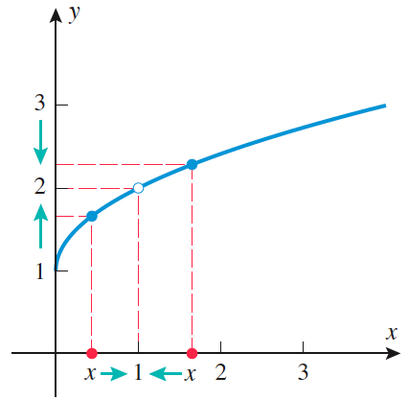
Geometrically, this can be viewed as follows:

Slide 21
Theorems on Limits
Theorem 1: Limit of a Constant
If c is a constant, then for any number a
Theorem 2: Limit of the Identify Function
Theorem 3: Limit of a Linear Function
If m and b are constants
Theorem 4: Limit of the Sum or Difference of Functions

Slide 22
Theorem 5: Limit of the Product
Theorem 6: Limit of the n^{th} Power of a function

Slide 23
Theorem 7: Limit of a Quotient
Theorem 8: Limit of the n^{th} Root of a Function

Slide 24
Sample Problems
Using the theorems on Limits, evaluate each of the following:
1. 6. Let
2. find:
3.
4.
5.

Slide 25
Definition of One-Sided Limits
Informal Definition:
If the value of f(x) can be made as close to L by taking the value of x sufficiently close to a , but always greater than a , then
read as “the limit of f(x) as x approaches a from the right is L.”
Similarly,
if the value of f(x) can be made as close to L by taking the value of x sufficiently close to a , but always less than a , then
read as “the limit of f(x) as x approaches a from the left is L.”
If both statements are true and equal then .

Slide 26
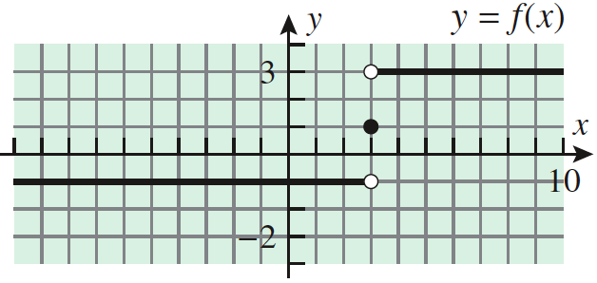
Geometrically,

Slide 27
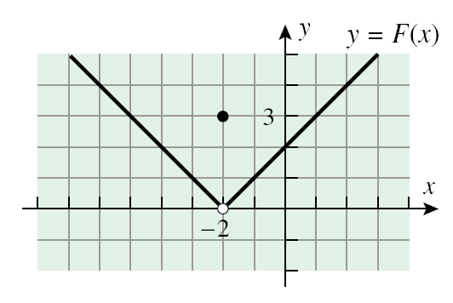

Slide 28
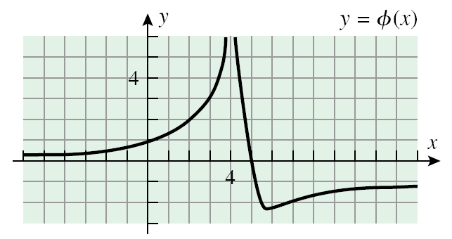

Slide 29
Infinite Limits
The expressions
denote that the function increases/decreases without bound as x approaches a from the right/ left and that f(x) has infinite limit.
A function having infinite limit at a exhibits a vertical asymptote at x = a.

Slide 30
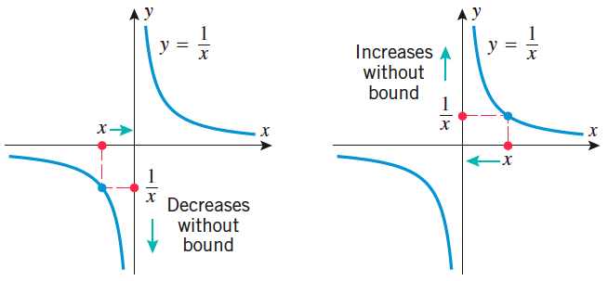

Slide 31
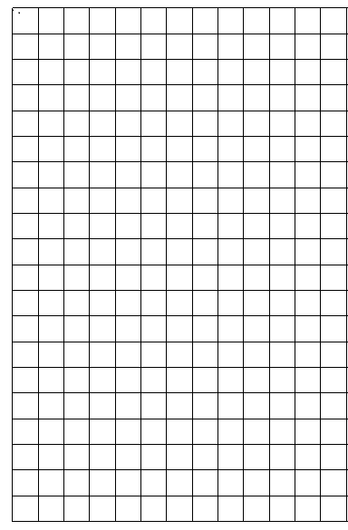
Geometrically;
0
0
x=a
x=a

Slide 32
Limits at Infinity
If as x increases/decreases without bound, the value of the function f(x) gets closer and closer to L then
If L is finite, then limits at infinity is associated with the existence of a horizontal asymptote at y = L.

Slide 33
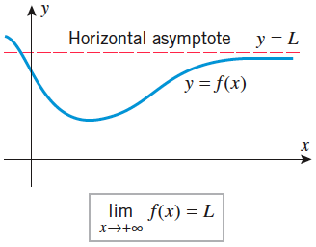
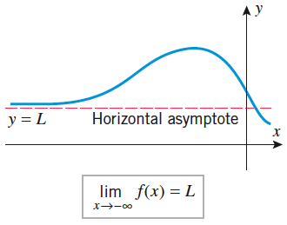
Geometrically,

Slide 34
Y=L
0
Y=L
0

Slide 35
LIMITS OF FUNCTIONS USING THE SQUEEZE PRINCIPLE
The Squeeze Principle is used on limit problems where the usual algebraic methods (factoring, conjugation, algebraic manipulation, etc.) are not effective. However, it requires that you be able to ``squeeze'' your function in between two other ``simpler'' functions whose limits are easily evaluated and equal. The use of the Squeeze Principle requires accurate analysis, deft algebra skills, and careful use of inequalities.

Slide 36
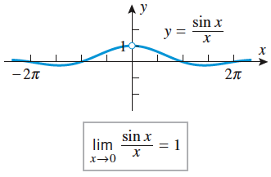
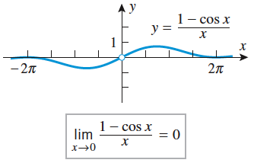
Theorem:

Slide 37
Sample Problems

Slide 38
Sample Problems

Slide 39
Lesson 2 : Continuity of Function

Slide 40
DEFINITION: CONTINUITY OF A FUNCTION
Definition:
A function f(x) is said to be conrinuous at x = c if and only if the following conditions hold:
If one or more of the above conditions fails to hold at c the function is said to be discontinuous at c.
A function that is continuous on the entire real line is said to be continuous everywhere.

Slide 41
If functions f and g are continuous functions at x = c, then the following are true:
a. f + g is continuous at c
b. f – g is continuous at c
c. fg is continuous at c
d. f/g is continuous at c provided g( c ) is not
zero.

Slide 42
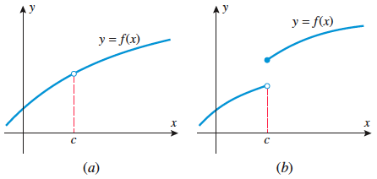
Types of Discontinuity
The figure above illustrates that the function is discontinuous at x=c and violates the first condition.
The figure above illustrates that the function is discontinuous at x = c and violates the second
condition. This kind of discontinuity is called jump discontinuity.

Slide 43
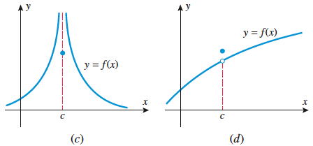
The figure above illustrates that the limit coming from the right and left of c are both undefined, thus the function is discontinuous at x = c and violates the second condition. This kind of discontinuity is called infinite discontinuity.
The figure above shows that the function is
defined at c and that the limit coming from
the right and left of c both exist thus the two
sided limit exist. However,
Thus, the function is discontinuous at x = c, violating the third condition.
This kind of discontinuity is called
removable discontinuity ( missing point).

Slide 44
Sample Problems
Investigate the discontinuity of the function f defined. What type of discontinuity is illustrated?
a) d.
b)
c)
Show the point(s) of discontinuity by sketching the graph of the function .

Slide 45
2. Find values of the constants k and m, if possible, that will make the function f(x) defined as
be continuous everywhere.

Slide 46
Lesson 3: The Derivative

Slide 47
Derivative of a Function
The process of finding the derivative of a function is called differentiation and the branch of calculus that deals with this process is called differential calculus. Differentiation is an important mathematical tool in physics, mechanics, economics and many other disciplines that involve change and motion.

Slide 48
y
tangent line
secant line
Consider:
-Two distinct points P and Q
-Determine slope of the secant
line PQ
Investigate how the slope
changes as Q approaches P.
Determine the limit of the
secant line as Q approaches P.
x

Slide 49
DEFINITION:
Suppose that is in the domain of the function f, the tangent line to the curve at the point is with equation
where provided the limit exists, and
is the point of tangency.

Slide 50
DEFINITION
The derivative of at point P on the curve is equal to the slope of the tangent line at P, thus the derivative of the function f with respect to x, given by , at any x in its domain is defined as:
provided the limit exists.
Note: A function is said to be differentiable at if the derivative
of y wrt x is defined at .

Slide 51
Other notations for the derivative of a function:
Note:
To find the slope of the tangent line to the curve at point P means that we are to find the value of the derivative at that point P.

Slide 52
THE Derivative of a Function based on the Definition ( The four-step or increment method)
To determine the derivative of a function based on the definition (increment method or more commonly known as the four-step rule)
, the procedure is as follows:
STEP 1: Substitute for x and
for y in
STEP 2: Subtract y = f(x) from the result of step 1 to
obtain in terms of x and
STEP 3: Divide both sides of step 2 by
STEP 4: Find the limit of the expression resulting from step 3 as
approaches 0.

Slide 53
Sample Problems
Find the derivative of each of the following functions based on the definition:

Slide 54
DERIVATIVE USING FORMULA
Finding the derivative of a function using the definition or the increment-method (four-step rule) can be laborious and tedious specially when the functions to be differentiated are complex. The theorems on differentiation will enable us to calculate derivatives more efficiently and hopefully will make calculus easy and enjoyable.

Slide 55
DIFFERENTIATION FORMULA
1. Derivative of a Constant
Theorem: The derivative of a constant function
is 0; that is, if c is any real number, then .
2. Derivative of a Constant Times a Function
Theorem: ( Constant Multiple Rule) If f is a differentiable function at x and c is any real number, then is also differentiable at x and
3. Derivatives of Power Functions
Theorem: ( Power Rule)
If n is a positive integer, then .

Slide 56
DIFFERENTIATION FORMULA
4. Derivatives of Sums or Differences
Theorem: ( Sum or Difference Rule) If f and g are both differentiable functions at x, then so are f+g and f-g , and
or
5. Derivative of a Product
Theorem: (The Product Rule) If f and g are both differentiable functions at x, then so is the product , and
or

Slide 57
DIFFERENTIATION FORMULA
6. Derivative of a Quotient
Theorem: (The Quotient Rule) If f and g are both differentiable functions at x, and if then is differentiable at x and
or
7. Derivatives of Composition ( Chain Rule)
Theorem: (The Chain Rule) If g is differentiable at x and if f is differentiable at g(x) , then the composition is differentiable at x. Moreover, if y=f(g(x)) and u = g(x) then y = f(u) and

Slide 58
DIFFERENTIATION FORMULA
8. Derivative of a Power
If u is a differentiable function of x and n is any real number , then
9. Derivative of a Radical with index equal to 2
If u is a differentiable function of x, then
10. Derivative of a Radical with index other than 2
If n is any positive integer and u is a differentiable function of x, then

Slide 59
Implicit Differentiation
On occasions that a function F(x , y) = 0 can not be defined in the explicit form y = f(x) then the implicit form F ( x , y) = 0 can be used as basis in defining the derivative of y ( the dependent variable) with respect to x ( the independent variable).
When differentiating F( x, y) = 0, consider that y is defined implicitly in terms of x , then apply the chain rule. As a rule,
Differentiate both sides of the equation with respect to x.
Collect all terms involving dy/dx on the left side of the equation and the rest of the terms on the other side.
Factor dy/dx out of the left member of the equation and solve for dy/dx by dividing the equation by the coefficient of dy/dx.

Slide 60
Higher Order Derivative
The notation dy/dx represent the first derivative of y with respect to x. And if dy/dx is differentiable, then the derivative of dy/dx with respect to x gives the second order derivative of y with respect to x and is denoted by .
Given:

Slide 61
Sample Problems
Differentiate y with respect to x. Express dy/dx in simplest form.

Slide 62
Sample Problems
Determine the derivative required:

Slide 63
References
Calculus, Early Transcendental Functions, by Larson and Edwards
Calculus, Early Transcendentals, by Anton, Bivens and Davis
University Calculus, Early Transcendentals 2nd ed, by Hass, Weir
and Thomas
Differential and Integral Calculus by Love and Rainville

